Slide 1

HGF for Behavioural Analysis: Perceptual Model for Anxiety Patients During Lockdown
Branca Francesco, Menini Davide, Sangalli Sara

Slide 2








Motivation: Lockdown in Italy
Lack of sanitary goods
Project Idea
Tests
Tests
Today
Mar
Apr
May
Jun
2020
Lockdown
Phase 2
Notes:
We would like to briefly present the context that led us to the idea for this project. We are 3 Italian students whose families have lived the lockdown in first person. We wanted to gather our personal experience with the subject of the course.

Slide 3

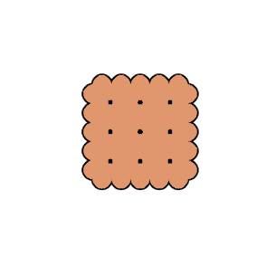











Goal: HGF for Anxiety Recognition
GOAL
Impartial Test
webapp
HGF
Psychologically Involving Test
webapp
HGF
Anxiety Quiz
webapp
HGF
Ground Truth

Slide 4

Experiment: Setup
Agents: 20-60 years old, both male and female
Tests randomly inverted to avoid boredom bias
Impartial Test: Biscuits in shop A (y | n) Are there biscuits in shop B?
Involving Test: Sanitizers in shop A (y | n) Are there sanitizers in shop B?
Anxiety Quiz: 20 questions based on STAI. 4 levels of anxiety detected, but only interested in a binary decision for results’ validation.

Slide 5
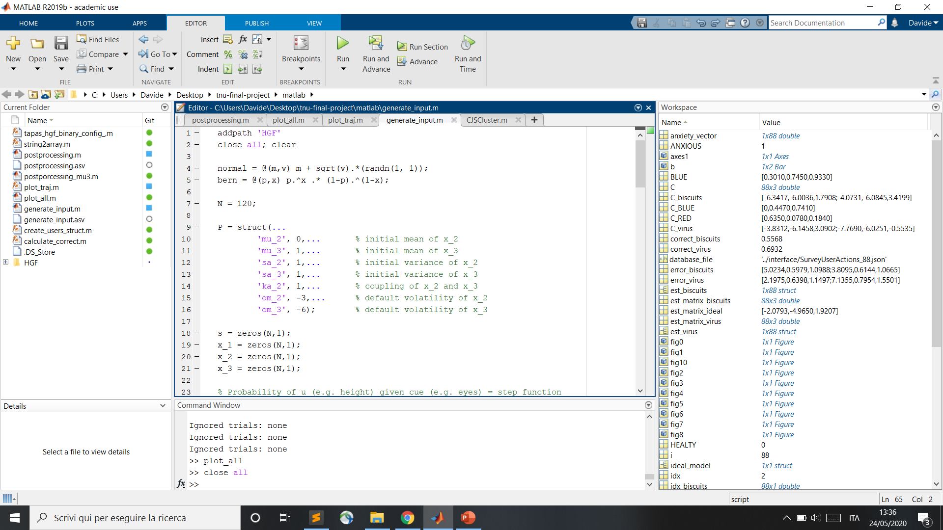
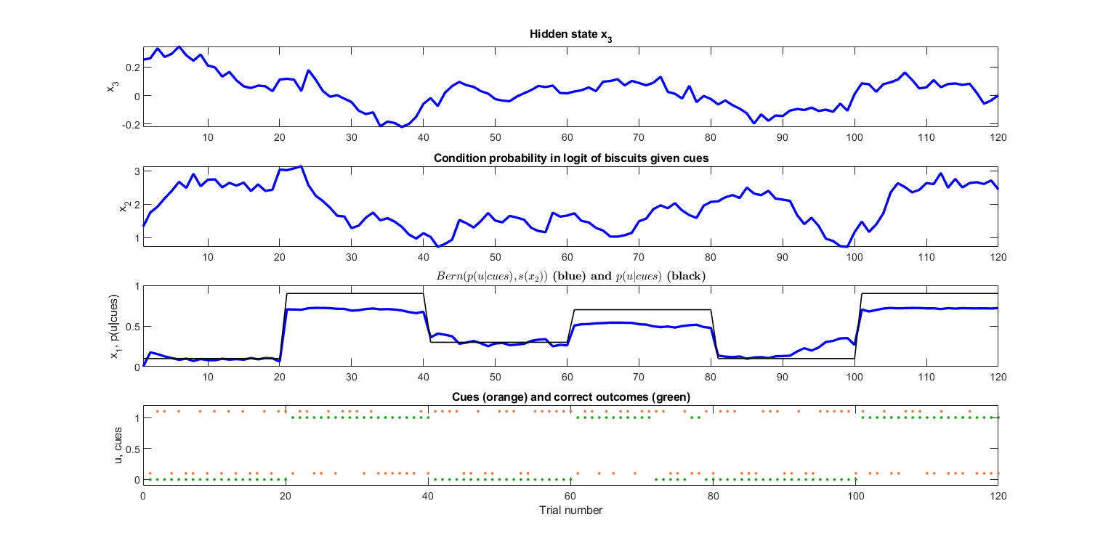
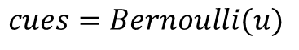
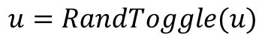
Experiment: Inputs
Correct Outcomes:
Cues:
Noisy Outcomes:
$$u=GenerativeModel(P, p(u|cues))$$
$$cues=Bernoulli(u)$$
$$u=RandToggle(u)$$

Slide 6
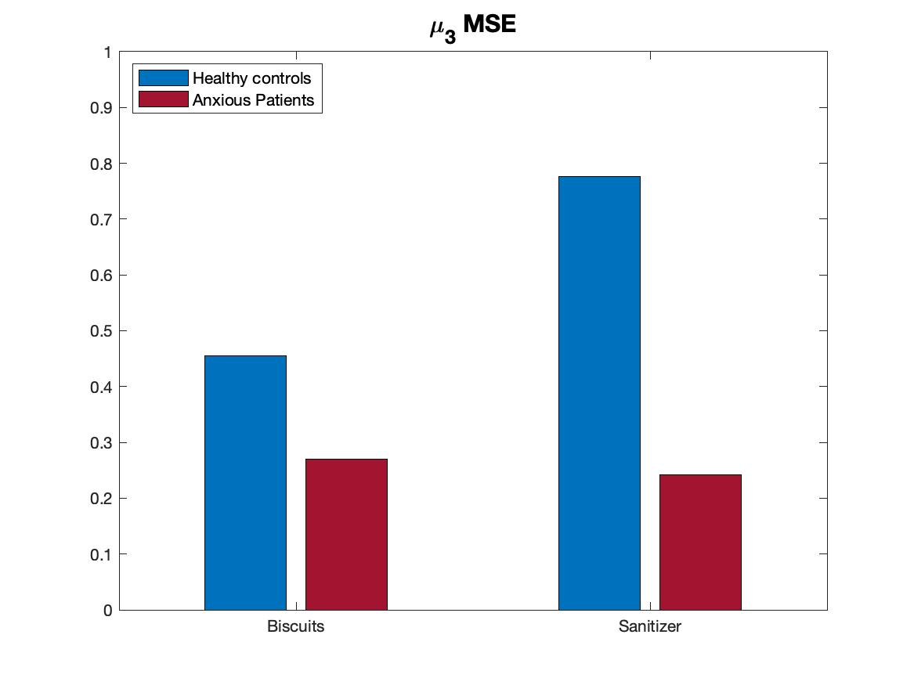
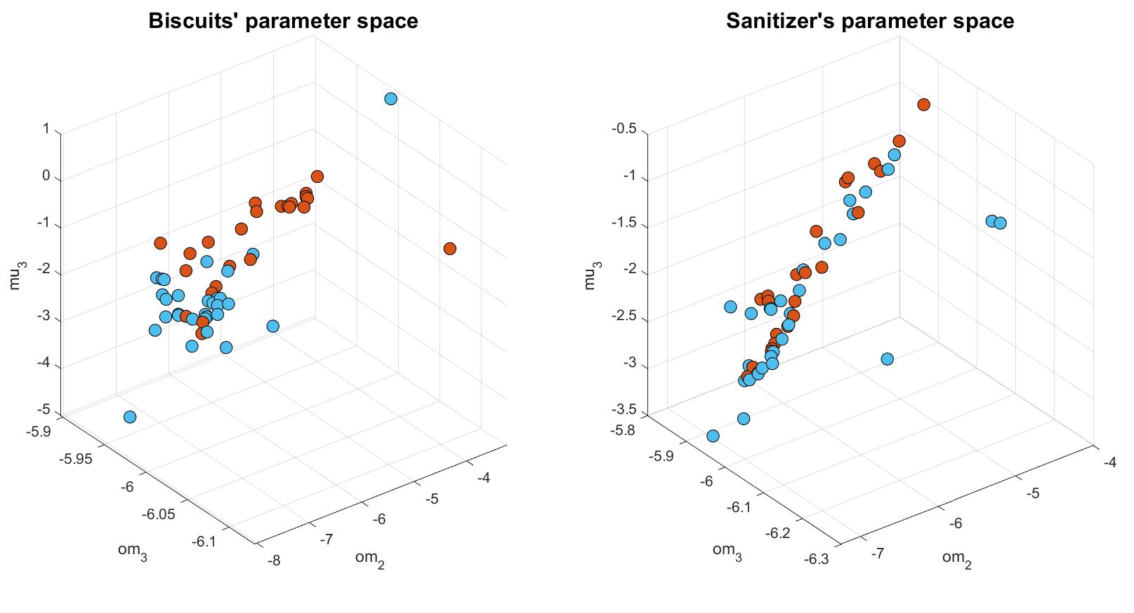
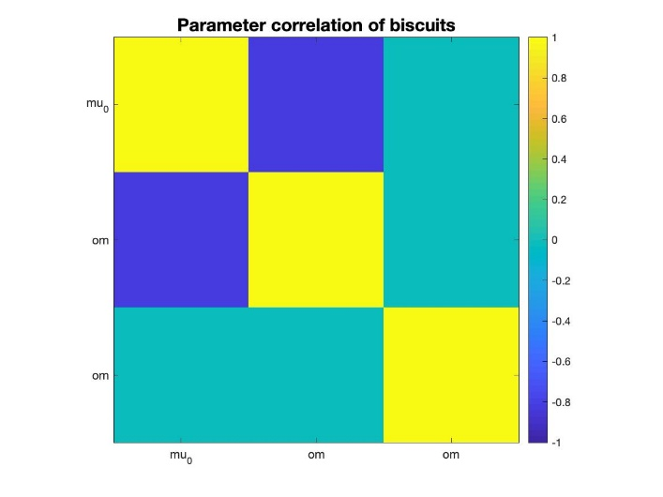
Parameter’s Estimation: Impartial vs. Involving
om₂
om₃
mu₃
om₂
om₃
mu₃
Notes:
Estimation of om2, om3 and mu3 using Tapas_fitModel. With the response model that we used, om2 and mu3 are exactly anticorrelated.

Slide 7
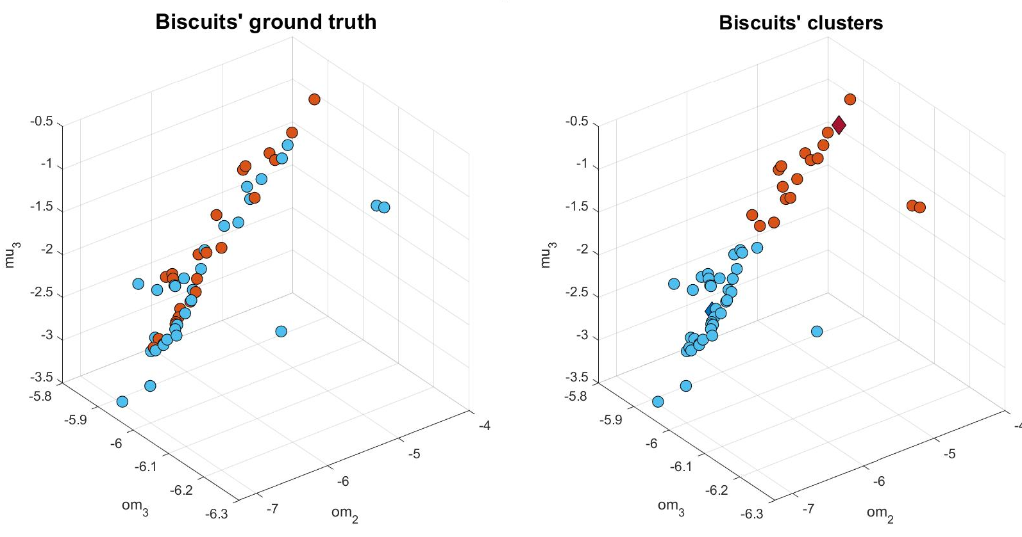
K-Means Clustering: Impartial Context

Slide 8
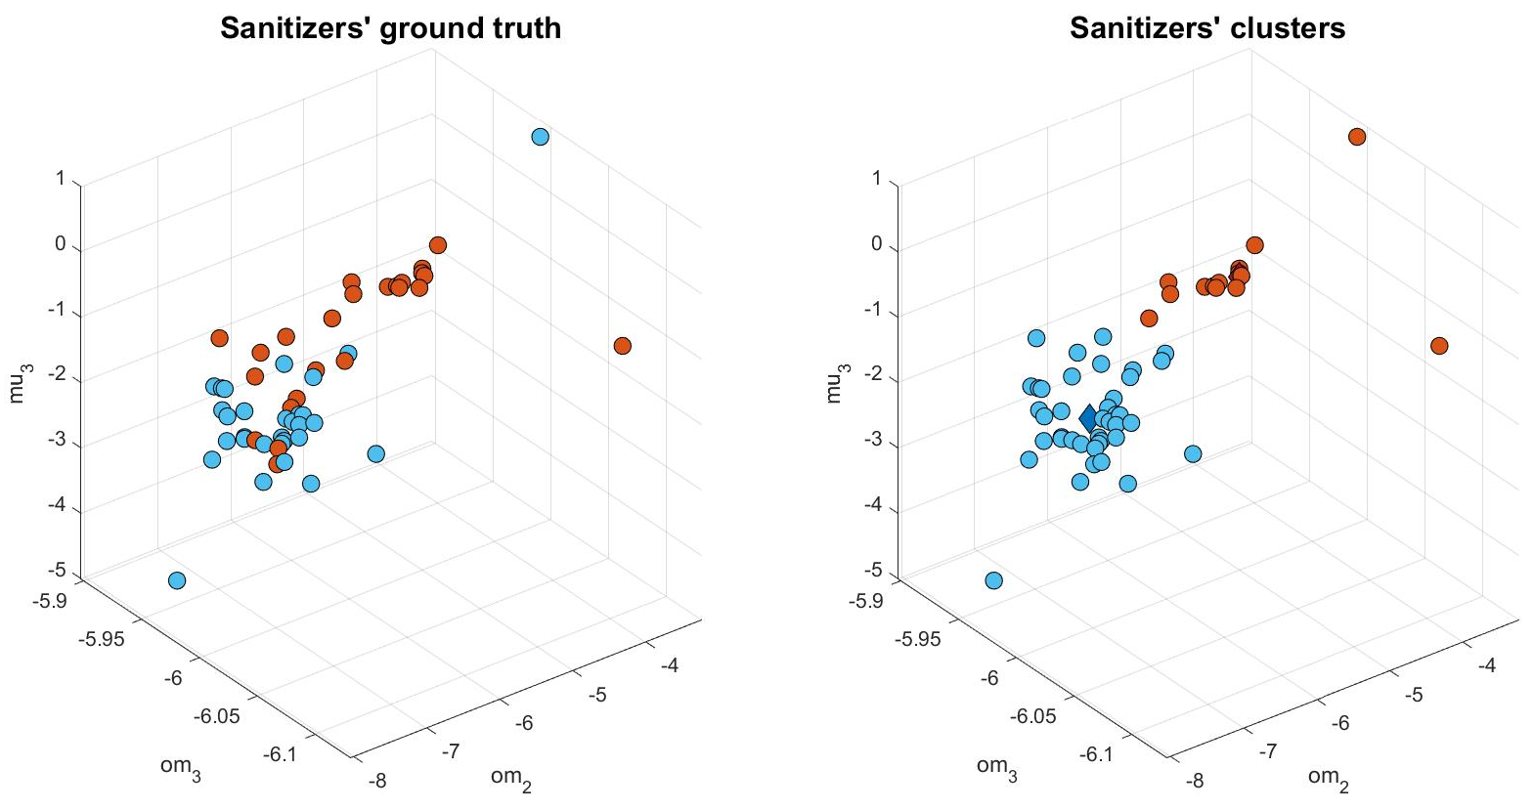
K-Means Clustering: Involving Context

Slide 9
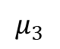
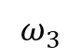
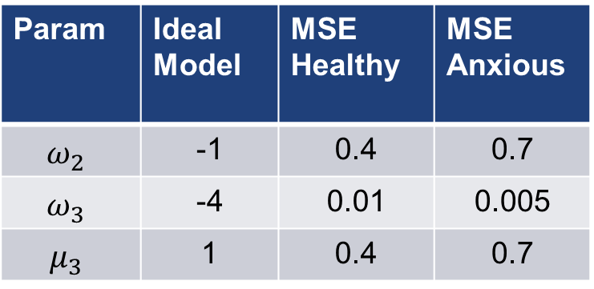
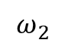
Comparison with Ideal Model
$$=MSE\left(est_ideal, est_h\left(i\right)\right) for i=1..N_h$$
$$=MSE\left(est_ideal,est_a\left(i\right)\right) for i=1..N_a$$
Healthy and anxious groups based on ground truth
Param | Ideal Model | MSE Healthy | MSE Anxious
$$ω_{2}$$ | -1 | 0.4 | 0.7
$$ω_{3}$$ | -4 | 0.01 | 0.005
$$μ_{3}$$ | 1 | 0.4 | 0.7
$$ω_{2}$$
$$ω_{3}$$
$$μ_{3}$$

Slide 10
Simulation of the Ideal Model

Slide 11
Simulation of the Ideal Model

Slide 12
Simulation of the Ideal Model

